Slide 1
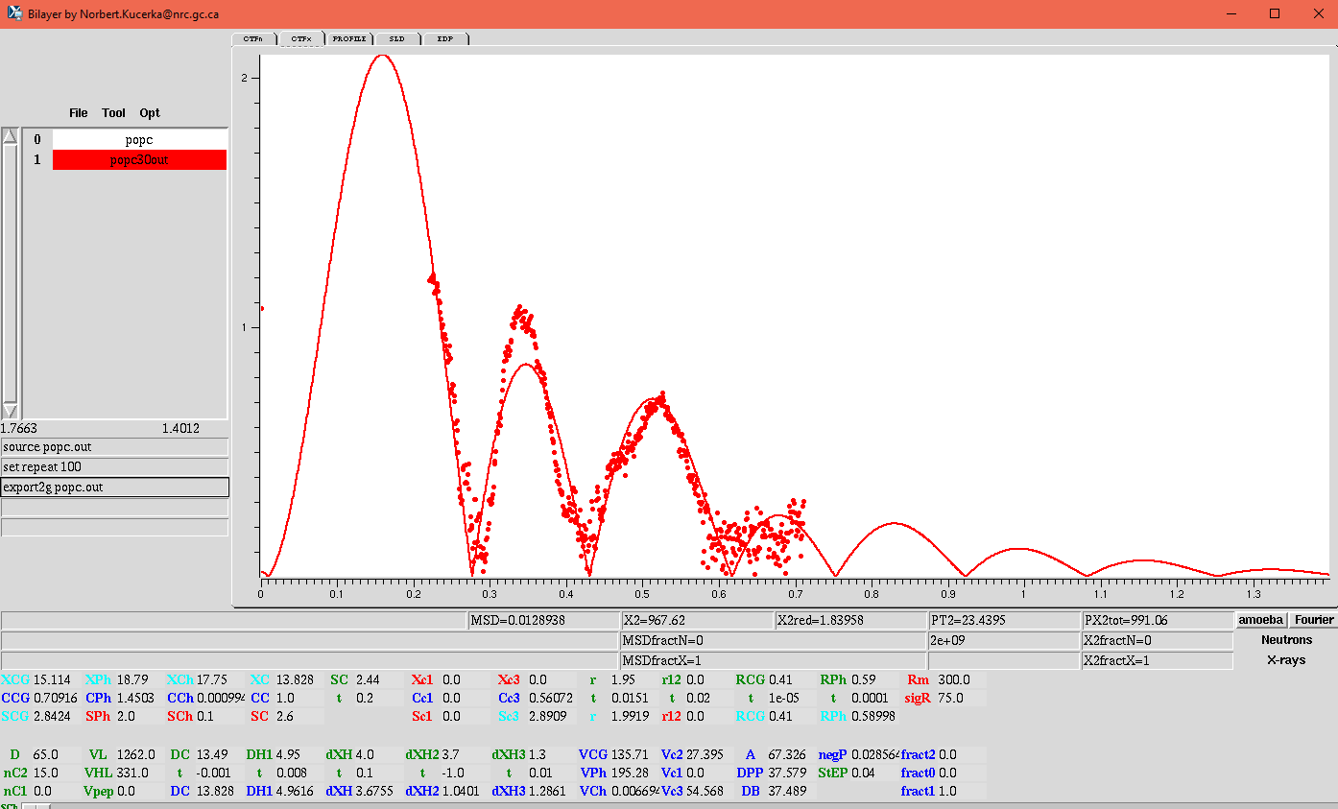
POPC FFs with model

Slide 2
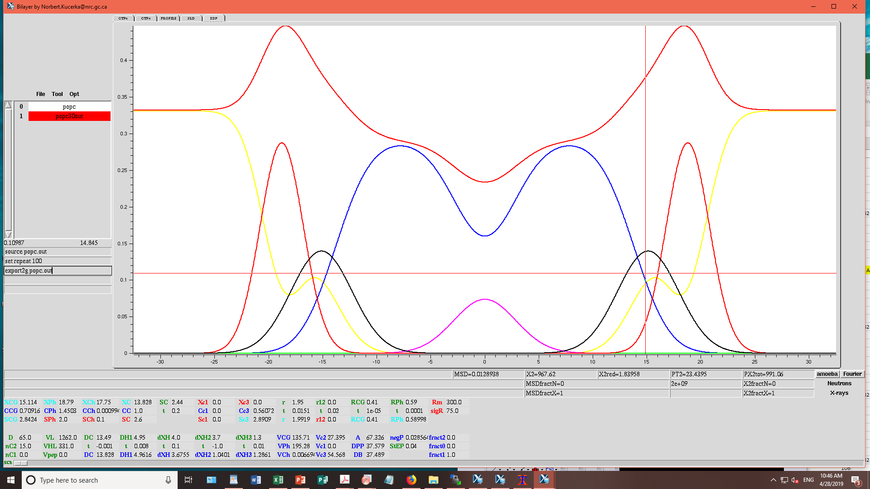
POPC
Area/lipid = 67.3 sq Ang.
2dc = 27.6 Ang.
VL = 1262 cu Ang.
Red chi sq = 1.84

