Slide 1
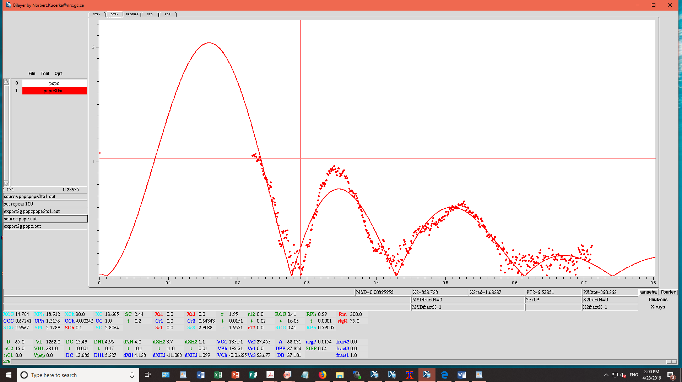
POPC

Slide 2
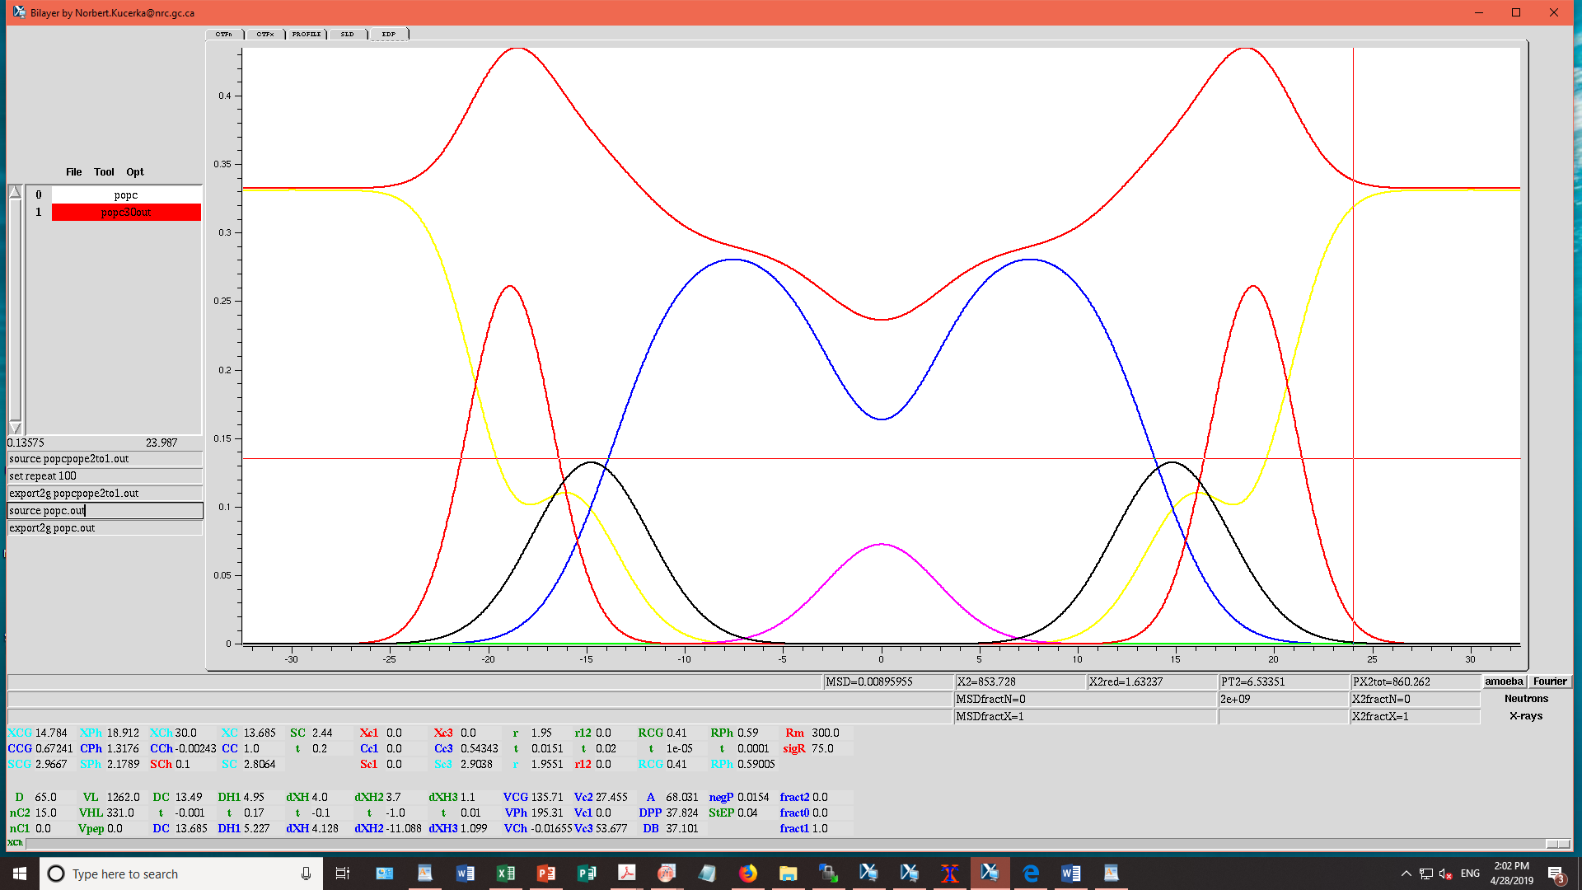
POPC
Area/lipid = 68.1 sq. Ang.
2Dc = 27.4 Ang.
VL = 1262 cu. Ang.
Red Chi. Sq = 1.63

Slide 3
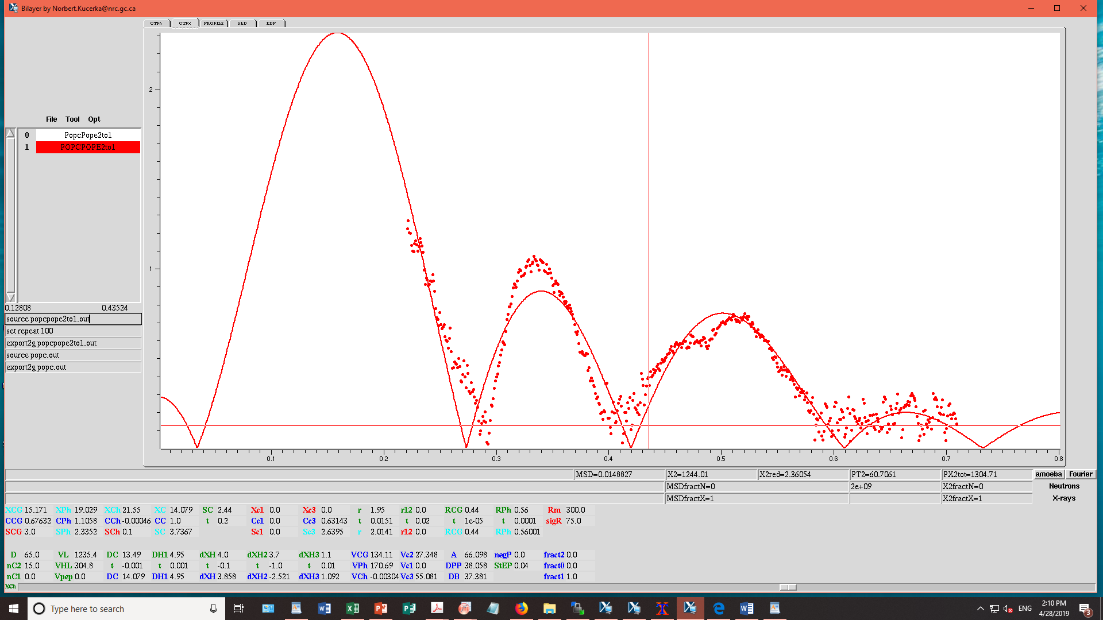
POPC:POPE 2:1

Slide 4
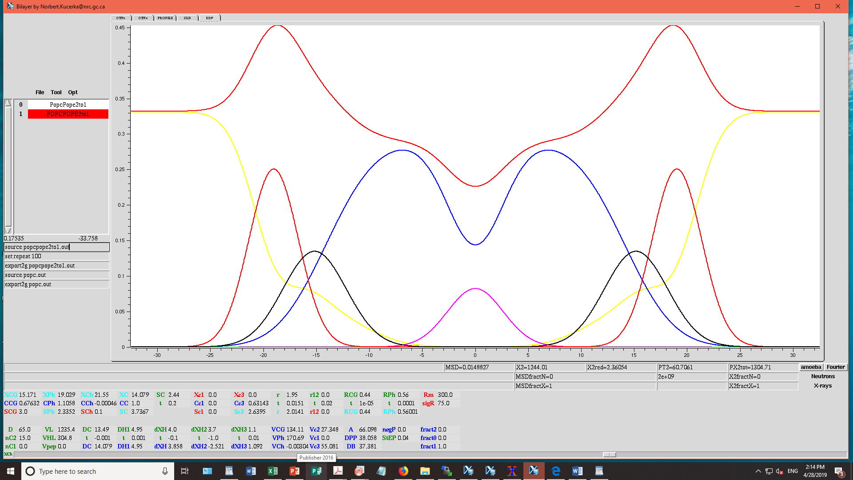
POPC/POPE 2:1
Area/lipid = 66.1 sq. Ang.
2Dc = 28.2 Ang.
VL = 1235.4
Red Chi. Sq = 2.36

Slide 5
POPC:POPE 1:1

Slide 6
POPC/POPE 1:1
Area/lipid = 64.9 sq Ang.
2Dc = 28.7 Ang.
VL = 1222.3 cu Ang.
Red Chi. Sq = 2.91

Slide 7
POPC:POPE 1:2

Slide 8
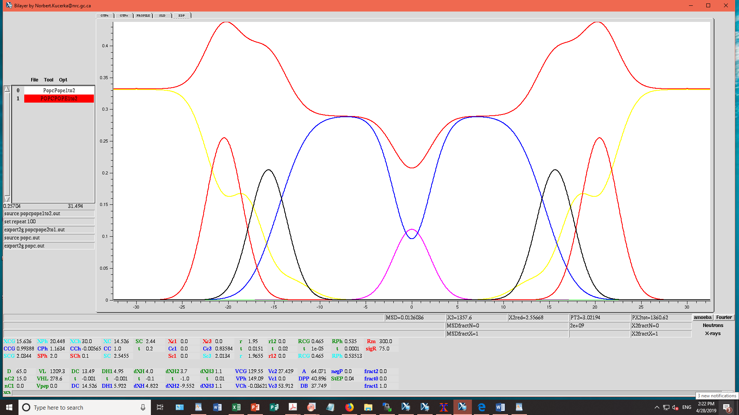
POPC/POPE 1:2
Area/lipid = 64.1 sq. Ang.
2Dc = 29.1 Ang.
VL = 1209.3 cu Ang.
Red Chi. Sq = 2.56

Slide 9
from experiments (STN&West)
PE = plasmalogen PE from MD simulation

Slide 11
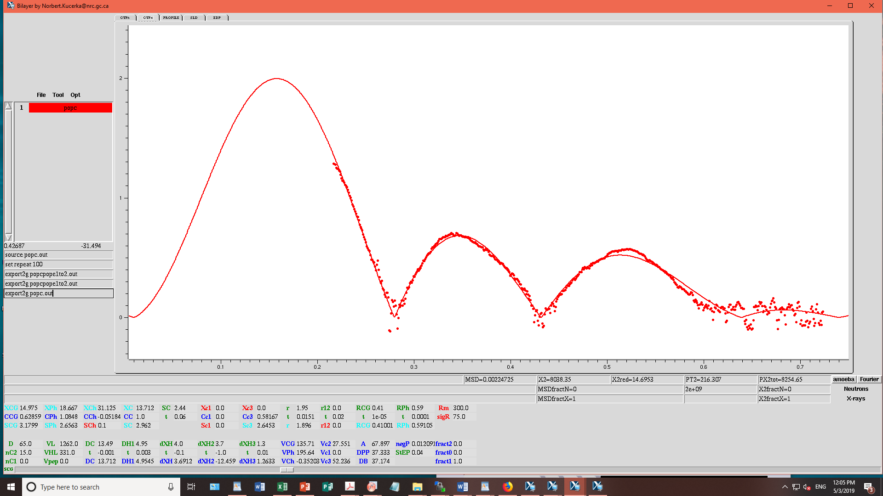
POPC

Slide 12
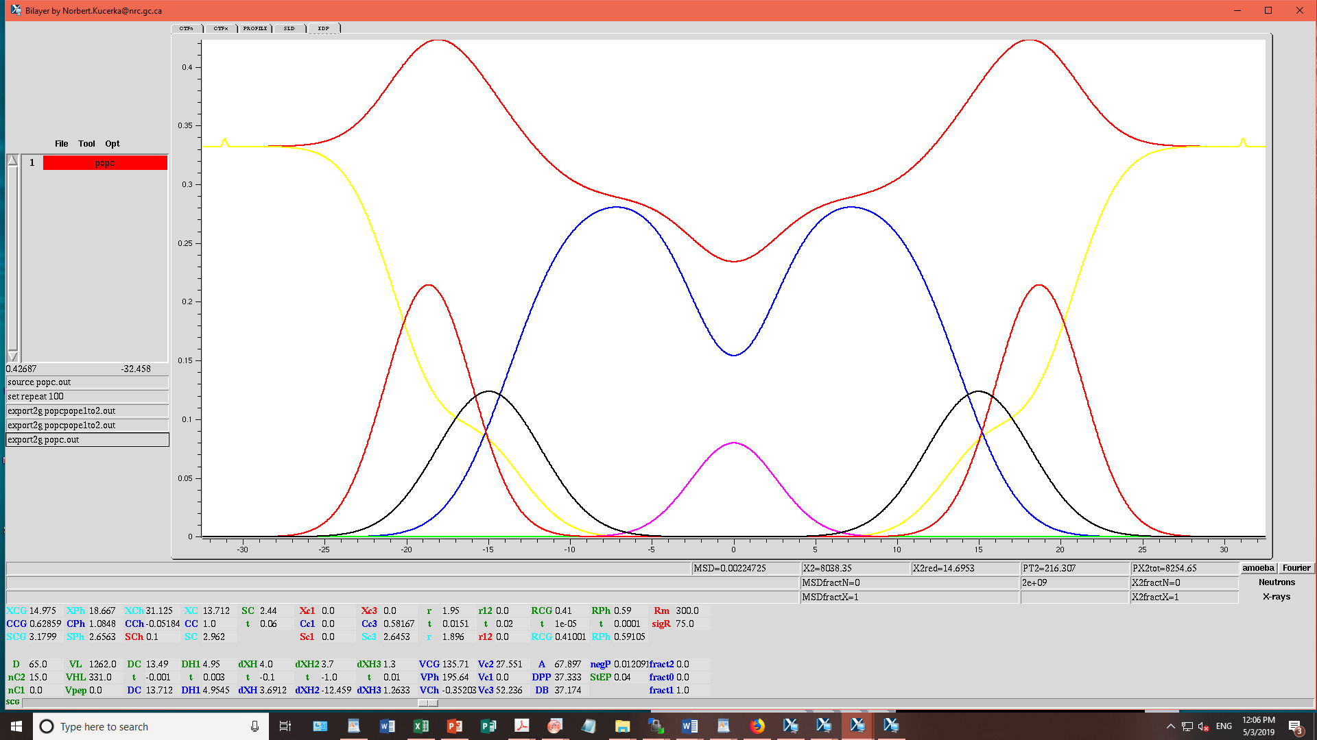
POPC
Area/lipid = 67.9 sq. Ang.
2Dc = 27.4 Ang.
VL = 1262 cu. Ang.
Red Chi. Sq = 14.7

Slide 13
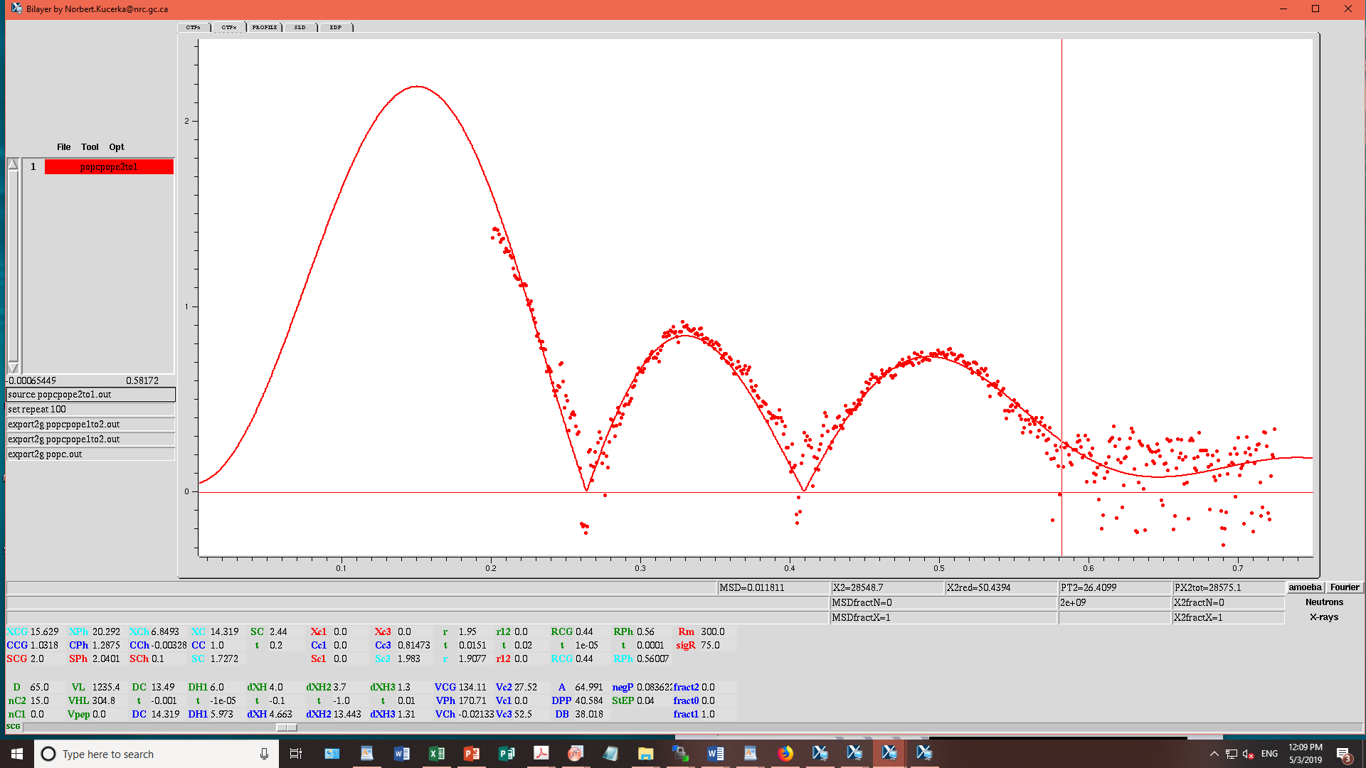
POPC/POPE 2:1

Slide 14
POPC/POPE 2:1
Area/lipid = 65 sq. Ang.
2Dc = 28.6 Ang.
VL = 1235.4
Red Chi. Sq = 50.44

Slide 15
POPC/POPE 1:1

Slide 16
POPC/POPE 1:1
Area/lipid = 63.6 sq Ang.
2Dc = 29.3 Ang.
VL = 1222.3 cu Ang.
Red Chi. Sq = 44.1

Slide 17
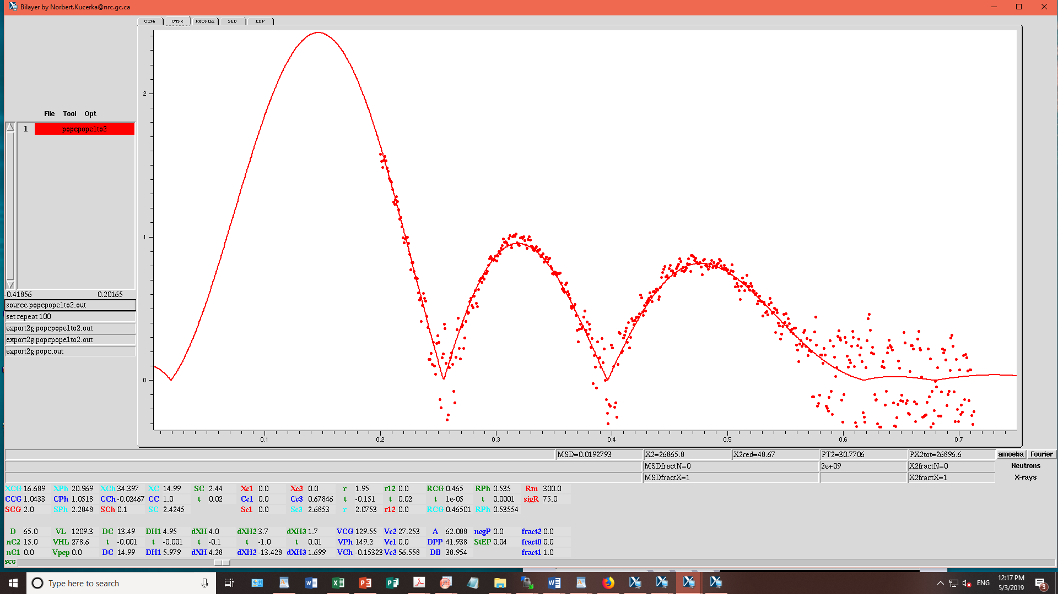
POPC/POPE 1:2

Slide 18
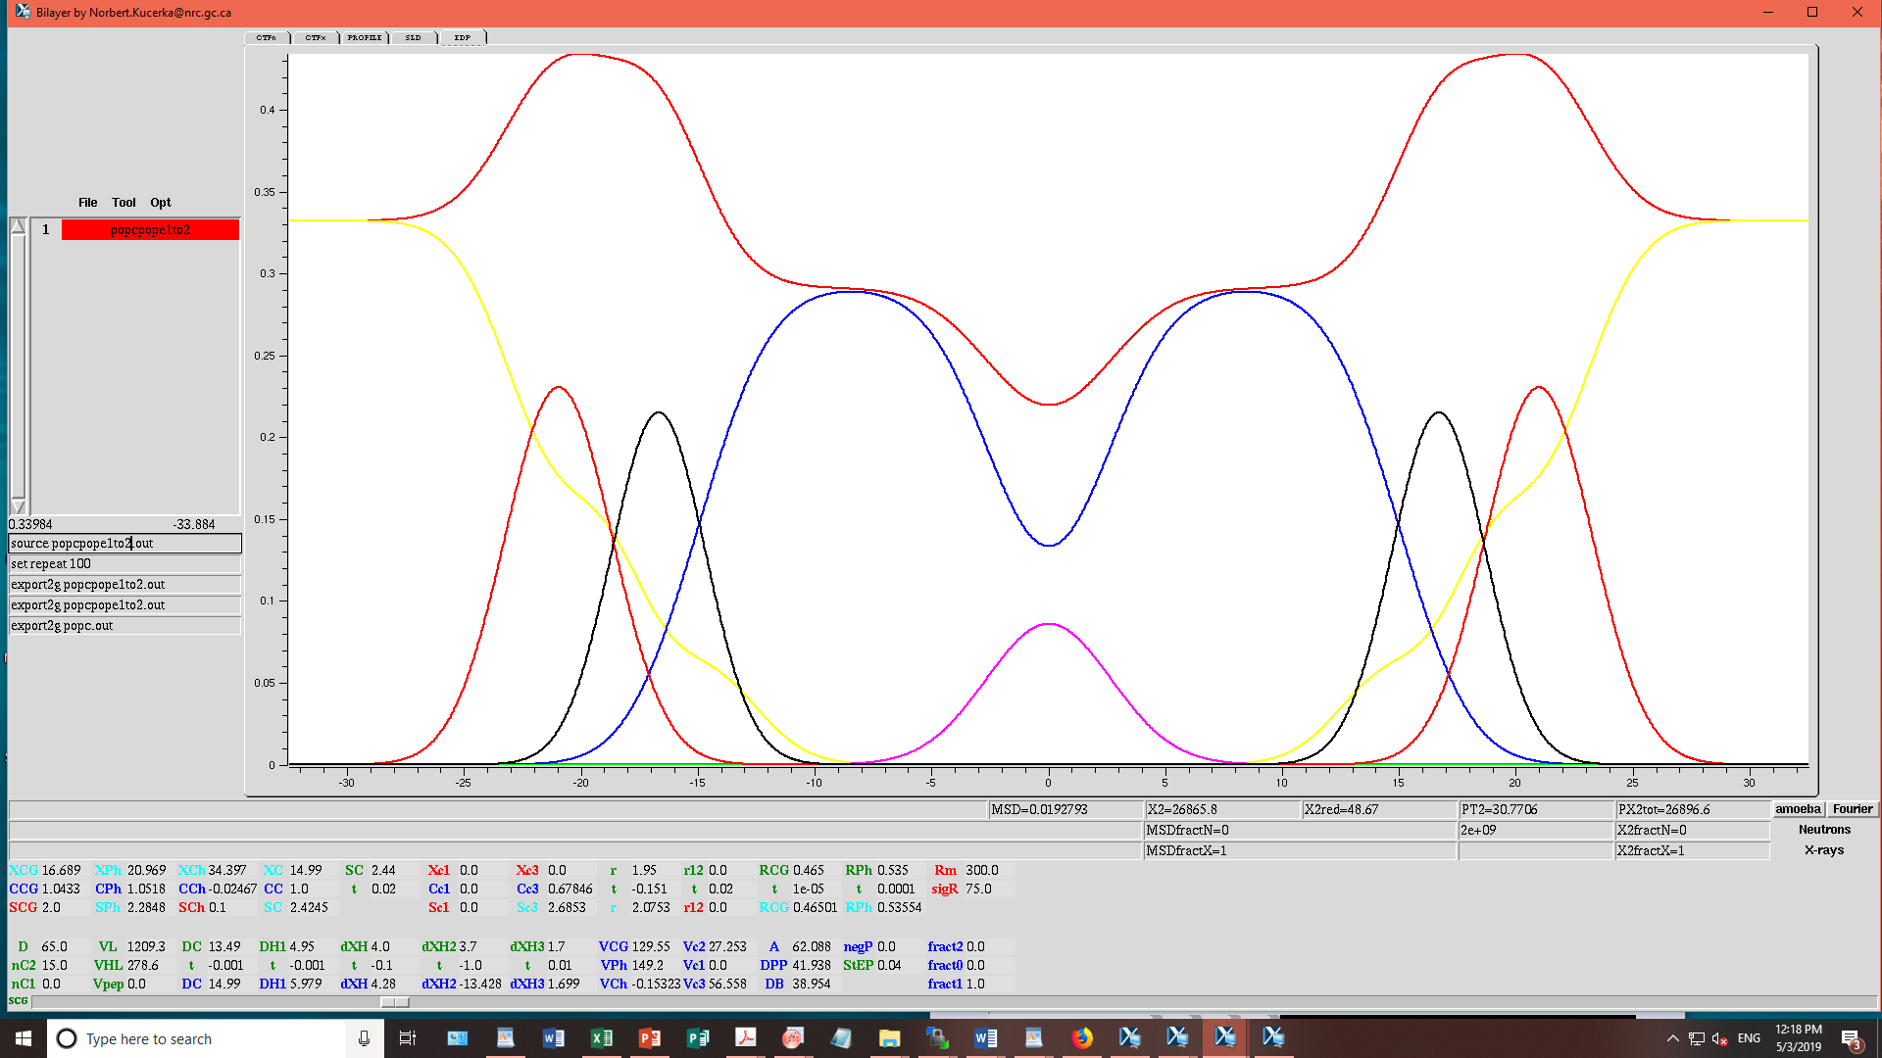
POPC/POPE 1:2
Area/lipid = 62.1 sq. Ang.
2Dc = 30 Ang.
VL = 1209.3 cu Ang.
Red Chi. Sq = 48.67

